Slide 1

RUSA Recovery Fund Data Analytics – Section 2
Fauzan Amjad | RUSA Department of COVID-19 Response and Recovery

Slide 2
Section 2A
Percentage of requests organized into demographic categories

Slide 4
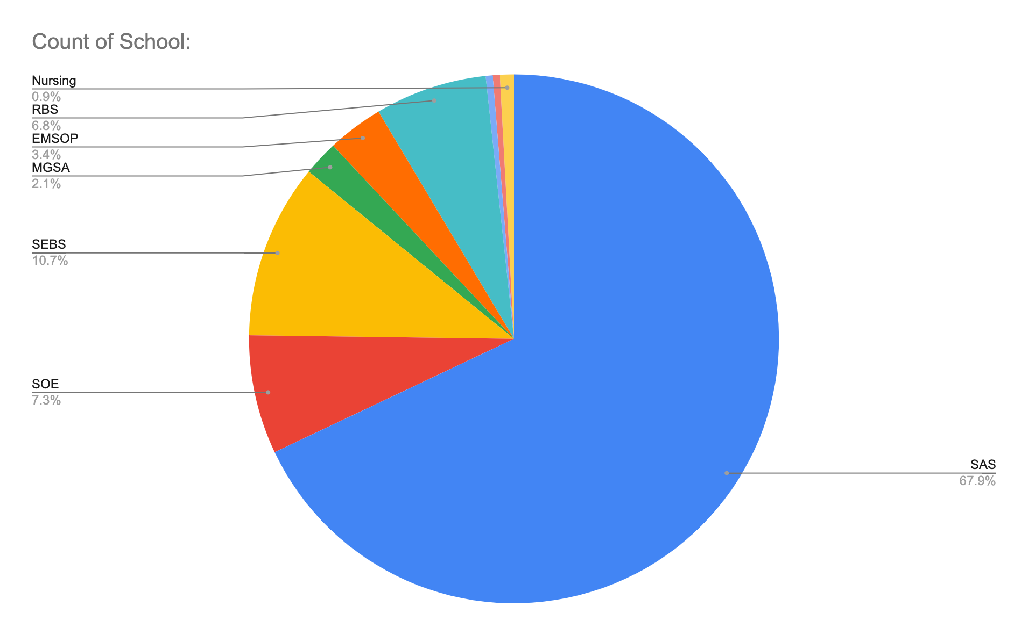

Slide 7
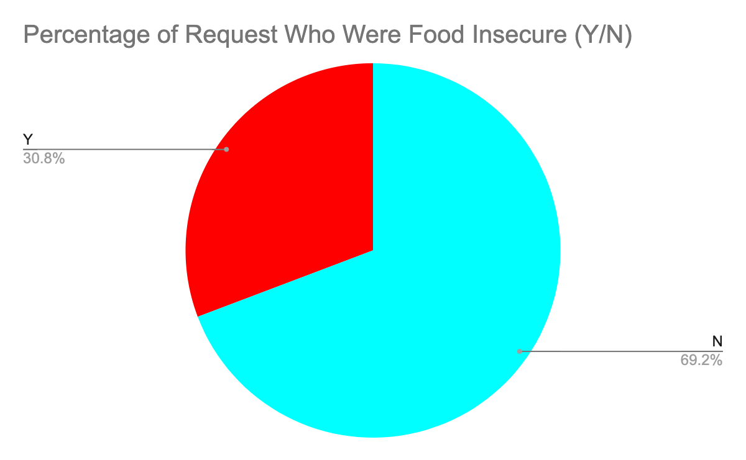

Slide 8
Section 2B
Percentage of people for which funds were granted based on given demographics

Slide 10
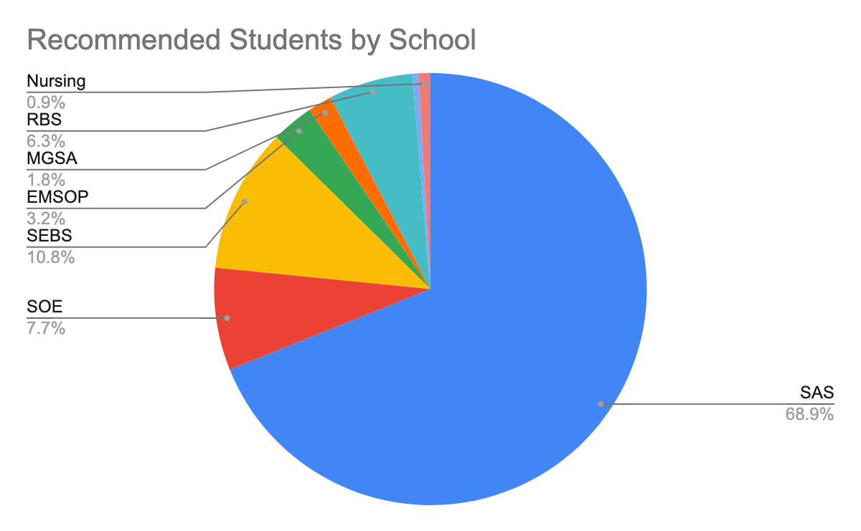

Slide 11
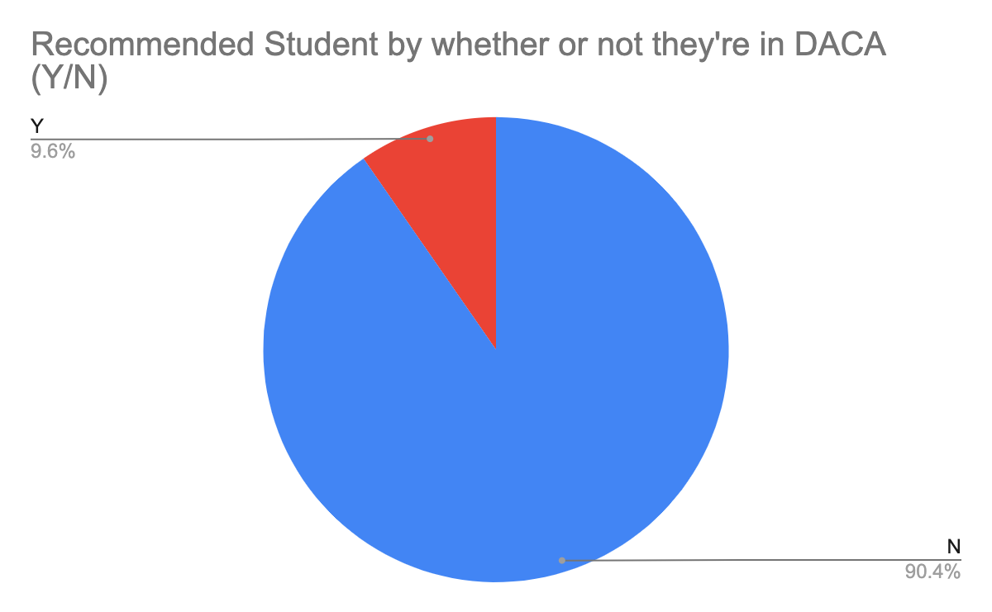

Slide 12
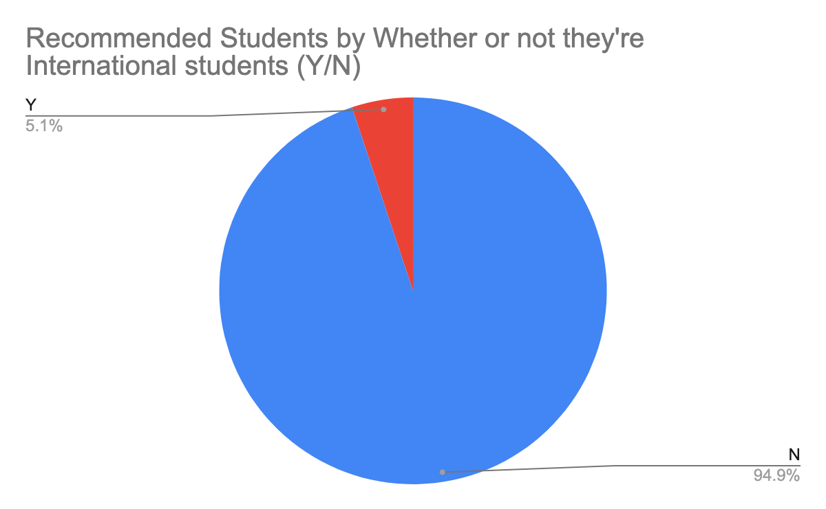

Slide 13
